Slide 1

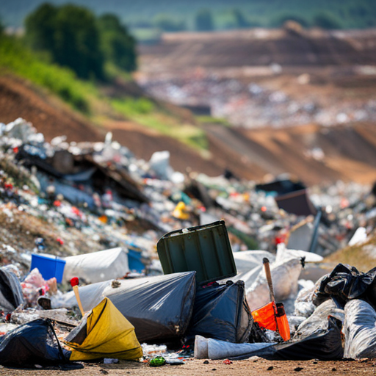
FORECASTING MUNICIPAL SOLID WASTE GENERATION IN MALAYSIA
FACULTY OF COMPUTER SCIENCE & INFORMATION TECHNOLOGY
MASTER OF DATA SCIENCE
NAME: NUR HIDAYAH BINTI AHMAD SHAFII (22120931)
LECTURER: PROF. TS. DR. RAFIDAH BINTI MD NOOR
EXAMINER: DR. BRYAN RAJ A/L PETER JABARAJ

Slide 2
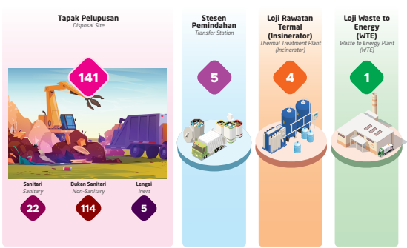
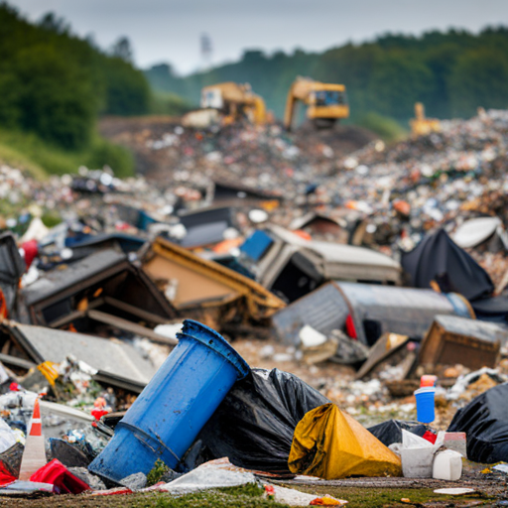
INTRODUCTION
MSW management is the regulation of waste generation, storage, collection, transfer, and disposal of unwanted materials or surplus substances no longer in use.
Over 39,000 tons of municipal solid waste generated daily; more than 30% is food waste Households are the largest contributors to food waste in Malaysia (Jereme et al., 2016; Ng et al., 2023).
Landfills remain the primary method with 141 facilities nationwide of MSW disposal in Malaysia due to their low cost and simplicity compared to more advanced methods like incineration, which requires specialized technical expertise and higher operational expenses (Syifaa et al., 2023).
Machine learning uncovers hidden patterns and relationships in MSW data that are often missed by traditional models. (Hoy et al., 2022; Niu et al., 2021)

Slide 3
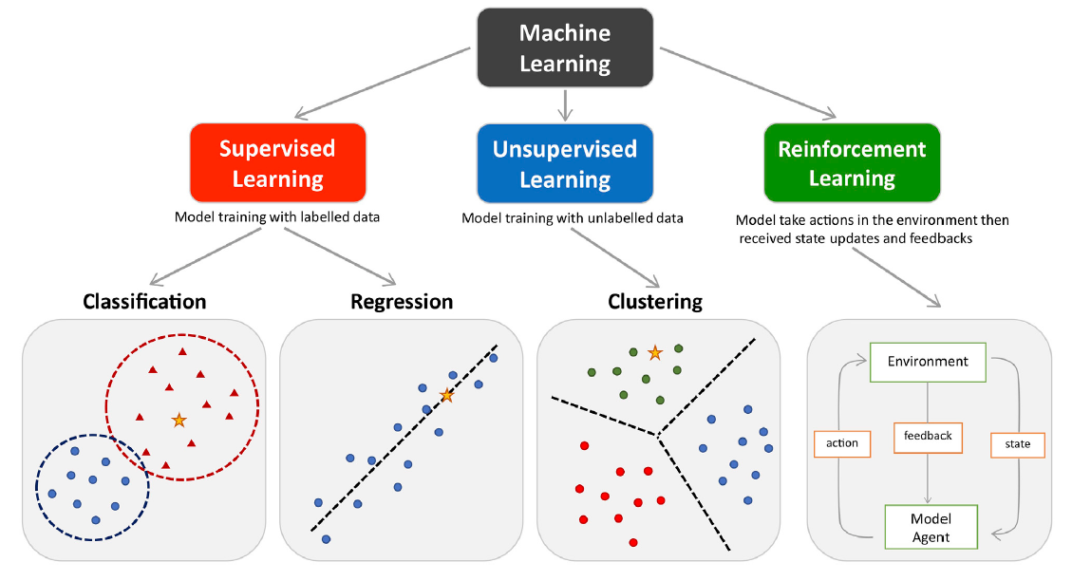
LITERATURE REVIEW
MACHINE LEARNING (ML)
Definition: Branch of artificial intelligence that uses data and algorithms to replicate human learning and improve accuracy over time (Peng et al., 2021).
Selecting the suitable ML depends on the problem, data type, and available resources. There is no single best method, as trial and error plays a key role (Sagi, 2024).
Supervised ML is widely used in MSW prediction for its ability to uncover nonlinear relationships in data (Peng et al., 2021).
ML helps in optimizing waste collection and recycling strategies (Hoy et al., 2022)

Slide 4
LITERATURE REVIEW
MACHINE LEARNING IN MSW PREDICTION (MALAYSIA)
Reference | Dataset source | Split | ML Technique | Independent variable | Findings | Research Gaps/Future Research
Nasir et al. (2023) | Solid Waste Management and Public Cleansing Corporation (SWCorp) | Not mentioned | ARIMA (AutoRegressive Integrated Moving Average) and ARMA (AutoRegressive Moving Average) | Past monthly MSW data | The results show that the MSW generated in some of the states such as Negeri Sembilan, Johor, Kedah, and Pahang exceeds the maximum landfill capacity. WPKL, Melaka, and Perlis show promising signs of stabilizing in terms of forecast value. | Results are limited to seven Malaysian states; external factors like socio-economic changes and population growth trends were not comprehensively considered.
Hoy et al. (2022) | Malaysia Department of Statistics and World Bank Database | Training: 80%, Testing: 20% | Bayesian-Optimised Artificial Neural Network (ANN), Ensemble Learning | Eight waste physical composition variables. Socioeconomic indicators (population, fertility rate, life expectancy, average working hours, GDP, human capital index, C02 emission energy and electric consumption) | The Bayesian-optimized ANN reduced overfitting and forecast uncertainty(3.64–27.7%) compared to default ANN models (11.1–44,400%). Based on the Bayesian-optimised ANN models, Malaysia will generate 42,873 t/d of MSW in 2030, comprising 44% of food waste. Each type of municipal solid waste physical composition (e.g., food waste, plastic) was found to be correlated with different socioeconomic indicators
Nasir et al. (2021) | Solid Waste Management and Public Cleansing Corporation (SWCorp) | Training: 75%, Testing: 25% | ARIMA (Autoregressive Integrated Moving Average) models | Past monthly MSW data | ARMA (2,2) and ARMA (3,1) were identified as the best models for Negeri Sembilan and Melaka, respectively. Landfills in both states are nearing their maximum capacity within one year. | Restricted to short-term forecasting and does not account for socio-economic or policy variables. The study recommends to use large data to improve the forecast.
Yusoff et al. (2018) | Department of Statistics Malaysia Official Portal, Solid Waste Management | Training: 70%, Testing: 30% | ANN using two hidden layers (10 and 5 nodes, respectively) | Population data | The ANN model with two hidden layers achieved an R² value of 0.988. Solid waste generation is predicted to increase by 29.03% from 2012 to 2031. | Data was not real-time data due to being restricted by confidentiality policies, and additional factors like household income were not considered.
Zulkipli et al. (2018) | SWCorp Malaysia and local governmental statistics | Not mentioned | An integrated dynamical solid waste management model | Population, MSW rate, and socio-economic factors (total income per service center, people per household, income per household) | MSW generation in Malaysia is forecasted to increase over time, reaching over 15 million tonnes by 2025. The main factor of MSW generation is population. Reducing the population alone is not enough to reduce total solid waste, and further actions are needed. | Should consider other variables like recycling rate planned for future research.

Slide 5
LITERATURE REVIEW
MACHINE LEARNING IN MSW PREDICTION
Reference | Dataset source | Country | Split | ML Technique | Independent variable | Findings | Research Gaps/Future Research
Elshaboury et al. (2021) | Central Statistical Office of Poland | Poland | Training: 80%, Testing: 20% | ANN, ANN coupled with particle swarm optimization (PSO) | Population, employment to population ratio, revenue per capita, number of entities by type of business activity | The ANN–PSO model achieved high accuracy (R = 0.96), significantly outperformed the traditional ANN models. | Limited to Polish datasets
Araiza-Aguilar et al. (2020) | Government demographic and census data | Mexico | Training: 70%, Testing: 30% | MLR | Population density, migration rate, socioeconomic factors | MLR achieved an adjusted R² of 0.975 with 7.7% MAE error for predicting waste generation. | Need for adapting the model to diverse geographic and social contexts to ensure broader applicability.
Dissanayaka & Vasanthapriyan (2019) | Department of Census and Statistics and National MSW Support Center | Sri Lanka | Training: 80%, Testing: 20% | MLR, ANN, RF | Socio-economic indicators (total population, GDP growth rate, crude birth rate) | ANN achieved the highest accuracy with R² = 0.9923, followed by RF (R² = 0.9608) and MLR (R² = 0.6973). Crude birth rate and GDP growth rate showed strong positive correlations with MSW generation. | Lack of reliable data and information on MSW generation in developing countries, leading to uncertainties in forecasting. Missing data in the dataset, which was addressed by imputing average values
Kumar et al. (2018) | Household surveys and plastic waste sampling | India | Training: 75%, Testing: 25% | ANN, RF, SVM | Socioeconomic parameters (e.g., income, education, occupation, housing type) | Higher socioeconomic groups (HSEG) had the highest plastic waste generation (51 g/c/d), while lower groups (LSEG) generated the least (8 g/c/d). Informal recyclers played a major role in recycling and revenue generation. | Need for formalizing the recycling sector and including socioeconomic impacts in modeling for better management plans.
Kumar & Samadder (2017) | Household surveys and waste sampling | India | Training: 80%, Testing: 20% | MLR | Household size, income, education, fuel usage | Biodegradable waste and non-biodegradable waste prediction showed R² values of 0.782 and 0.676, respectively. | Inclusion of temporal variations and larger datasets to enhance model predictions and accuracy.
Azadi & Karimi-Jashni (2016) | Government records and climate databases | Iran | Training: 70%, Testing: 30% | ANN, MLR | Population, collection frequency, maximum seasonal temperature, altitude | ANN outperformed MLR in predicting seasonal MSW generation rates. | Further validation using more diverse datasets and exploration of hybrid machine learning techniques.
Ghinea et al. (2016) | Local municipal data | Romania | Training: 75%, Testing: 25% | Regression Analysis, Waste Prognostic Tool, Time Series Analysis | Socio-economic indicators: number of residents, population aged 15–59, urban life expectancy, and total MSW | Regression analysis identified population aged 15–59 strongly influences MSW generation. The S-Curve trend model is the most suitable for MSW prediction for total waste. | Socio-economic factors like GDP and broader datasets were suggested for future studies.

Slide 6
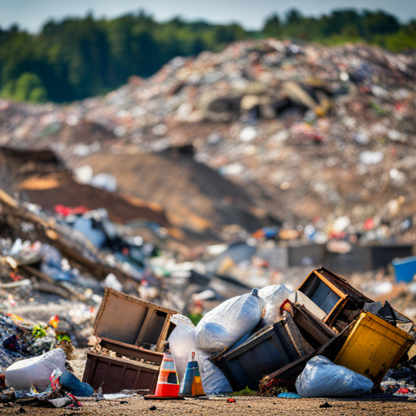
PROBLEM STATEMENT
Integration socioeconomic and environmental factors
Araiza-Aguilar et al. (2020), Yusoff et al. (2018), Azadi & Karimi-Jashni (2016) and Ghinea et al. (2016) emphasize the role of demographic factors (e.g., urbanization, population) as key drivers of MSW generation but do not consider socioeconomic factors (e.g., GDP, crude birth rate).
Dissanayaka & Vasanthapriyan (2019) found that variables like GDP growth rate, crude birth rate, and total population influence MSW generation in Sri Lanka.
These findings showed that influential variables vary based on regional and economic contexts.
Comparative Evaluation of Predictive Model Performance
Research in Malaysia has primarily focused on time-series approaches (Nasir et al., 2023;) or advanced machine learning algorithms (Hoy et al., 2022; Yusoff et al., 2018; Zulkipli et al., 2018)
Lack of exploration of simpler model and need for a comparative evaluation of multiple methods. (Araiza-Aguilar et al., 2020; A. Kumar et al., 2018)

Slide 7
RESEARCH QUESTION
What are the key variables that influence the amount of waste generation?
How accurate and reliable can Linear Regression, Random Forest, and Artificial Neural Networks predict solid waste generation?
RESEARCH OBJECTIVES
To identify and analyze influential variables that affect the amount of waste generation.
To evaluate the predictive performance of Linear Regression, Random Forest, and Artificial Neural Networks models for solid waste generation.

Slide 8
RESEARCH SCOPE
Geographical Scope
Focus on states and federal territories that operate under Act 672.
Act 672 was introduced to standardize and regulate solid waste management and public cleansing services.
Not all states in Malaysia have adopted Act 672
Six states (Johor, Kedah, Melaka, Negeri Sembilan, Pahang, Perlis) and two federal territories (Wilayah Persekutuan Kuala Lumpur, Putrajaya)
No data on Putrajaya (waste being disposed of at Tanjung 12, Selangor)
Dataset Coverage
Timeframe: Solid waste and recyclable waste data from 2017 to 2021.
Sources: Solid and recyclable waste data obtained from SWCorp archives, KPKT yearly statistics, and socio-economic/demographic factors from DOSM.
Machine Learning Analysis
Evaluate the predictive performance of Linear Regression, Random Forest, and Artificial Neural Networks.
Use socio-economic and demographic factors (GDP, GDP per capita, population size, urban and elderly population, fertility rates, household numbers, labor force participation, employment ratio, crude birth rate and crude death rates)

Slide 9
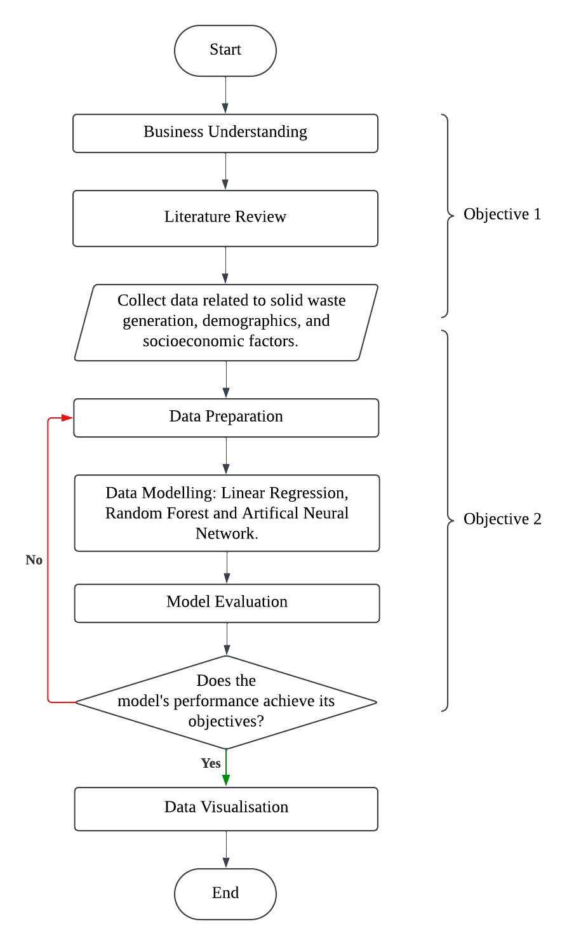
METHODOLOGY
Data Preparation
Boxplot to detect skewness and handle missing values
right-skewed distribution. Median imputation by grouping is suitable for numerical data with skewed distribution and outliers (Firdose, 2023; Huey, 2021).
median imputation by state and month.
Address multicollinearity using correlation heatmaps and variation inflation factor (VIF) .
- Some variables will be dropped to improve model performance and reduce complexity.
Standardize and unify data formats for consistency.
Data Modelling
Shuffling ensures each fold represents the full data distribution for reliable evaluation metrics (Dutta, 2024).
80/20 split for training and testing datasets
ANN architecture: 2 hidden layers (64 and 32 neurons) with ReLU activation.
ReLU is widely used due to its simplicity and computational efficiency while Sigmoid and Tanh are less preferred due to gradient issues (Hoy et al., 2022)
Data Evaluation
MAE, RMSE, and R² for performance assessment.
A predictive model performs best with high R² and low RMSE (A. Kumar & Samadder, 2017; Wohlwend, 2023).
Cross-validation for reliable evaluation and hyperparameter tuning.

Slide 10
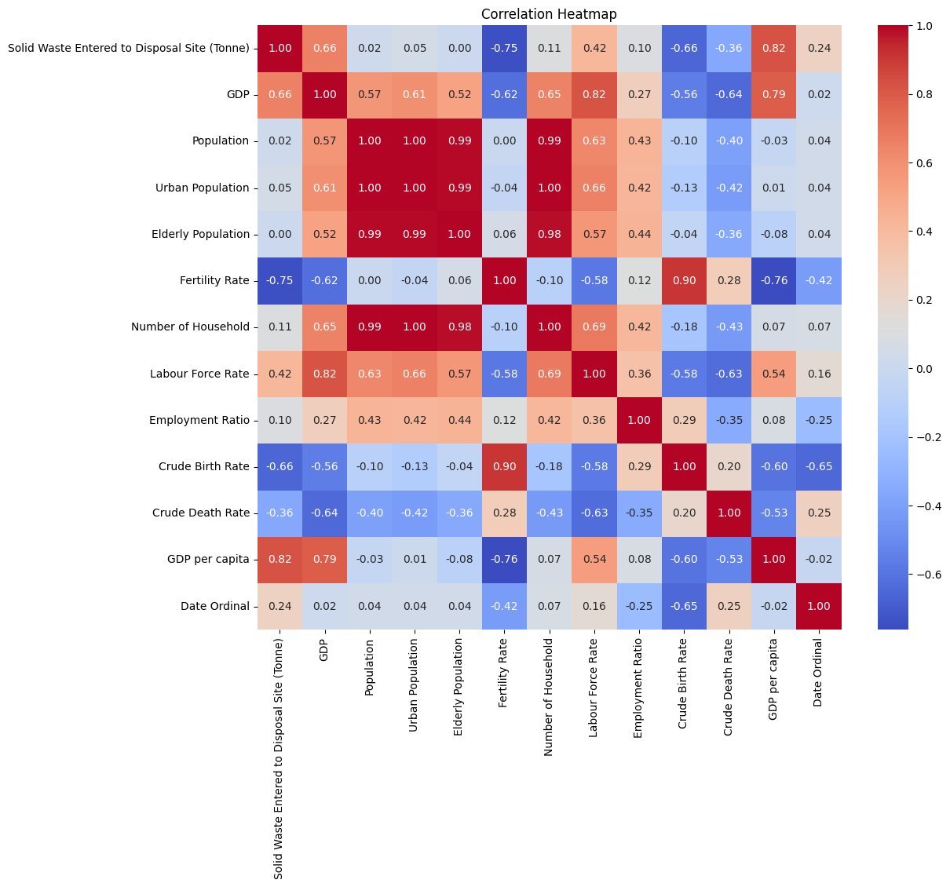
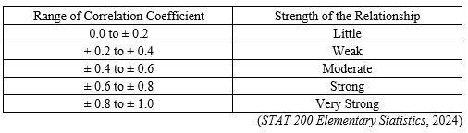
DATA PREPARATION: HEATMAP CORRELATION
Population correlated with Urban Population, Elderly Population, and Number of Households.
Fertility Rate correlated with Crude Birth Rate. Retained Fertility Rate (-0.75) due to stronger correlation with the target variable compared to Crude Birth Rate (-0.66).
GDP correlated with GDP per Capita and Labour Force Rate. Retained GDP per Capita (0.82) due to stronger correlation with the target variable than GDP (0.66).
Dropped Variables:Urban Population, Population, Number of Households, Elderly Population, Employment Ratio, GDP, Crude Birth Rate (due to high correlation or low relevance).

Slide 11
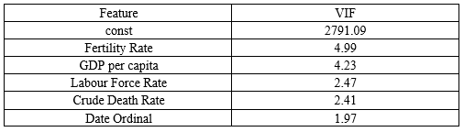
Variance Inflation Factor (VIF)
According to Ghinea et al. (2016) and Hoy et al. (2022), a VIF of 1 indicates no correlation among variables, a VIF between 1 and 5 suggests moderate correlation, and a VIF greater than 5 indicates high correlation.
Previous Studies:
Elshaboury et al. (2021), Araiza-Aguilar et al. (2020), Yusoff et al. (2018) found strong correlations between Population and waste generation but did not consider GDP as an influential factor. Similarly, Hoy et al. (2022), found that different types of municipal solid waste (MSW) compositions were correlated population and employment ratio. This may be due to the inclusion of specific MSW types, which can influence the socioeconomic indicators related to waste generation.
Dissanayaka & Vasanthapriyan (2019) found Crude Birth Rate, GDP growth rate, and Total Population as key influencers of MSW generation in Sri Lanka. Total Population showing a negative correlation in their findings.

Slide 12
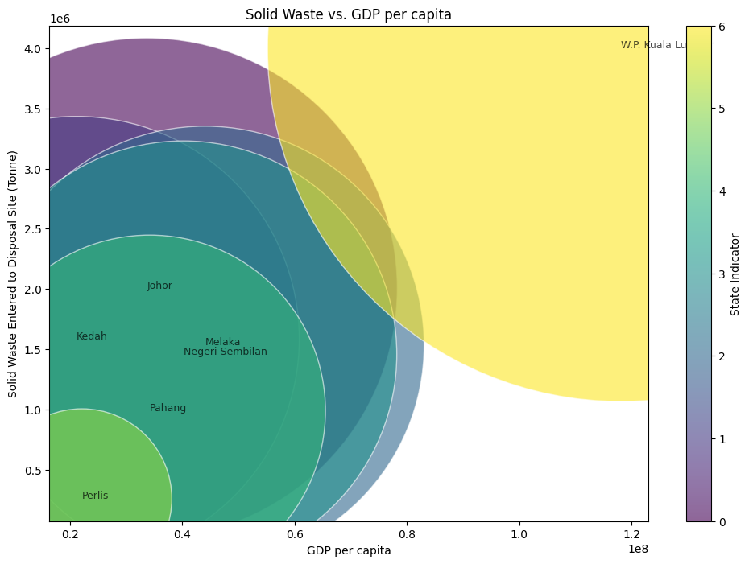
Analysis of GDP per Capita and Solid Waste Generation by State
Positive Correlation:
States with higher GDP per capita generate more solid waste.
W.P. Kuala Lumpur leads with the highest GDP per capita, producing over 4 million tonnes of waste.
Kedah generates 4x more waste than Perlis, despite similar GDP per capita (~RM 30M vs. RM 20M).
Johor, with GDP per capita one-third of W.P. Kuala Lumpur, ranks second in waste generation (~2 million tonnes), surpassing Melaka (second-highest GDP per capita).
Key Factors:
Johor's higher labor force participation drives economic activities and consumption, influencing waste output.
Wealthier regions generate more waste due to higher consumption of packaged goods (Abdella Ahmed et al., 2022; A. Kumar et al., 2018).
Lower socioeconomic areas produce more non-biodegradable waste due to affordability (A. Kumar & Samadder, 2017).

Slide 13
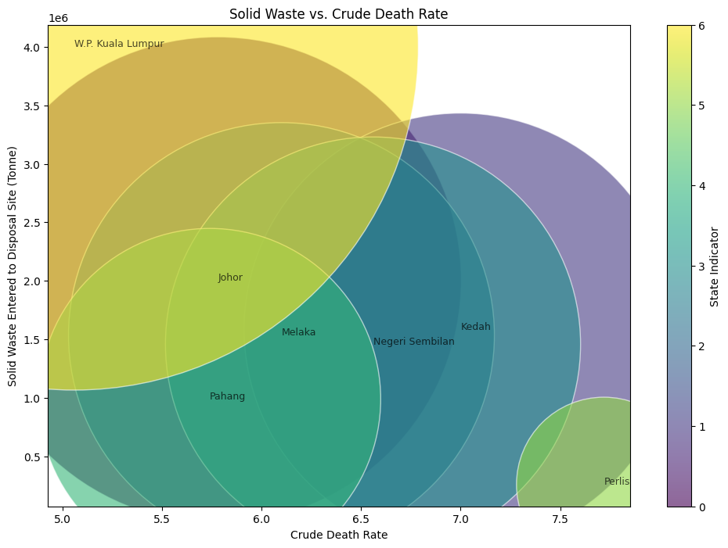
Analysis of Crude Death Rate and Solid Waste Generation by State
Key Observations:
Lower crude death rates (e.g., W.P. Kuala Lumpur, Johor) indicate younger populations and higher economic activity, leading to increased consumption and waste production.
Higher crude death rates (e.g., Perlis, Kedah) reflect older populations with reduced economic activity and lower waste generation.
Behavioral Insights:
Younger populations generate more food waste due to inexperience and lower involvement in prevention (Jamaludin et al., 2022; Abd Razak et al., 2018).
Older populations contribute to waste through healthcare product disposal and inefficient waste management practices (Acorn, 2019).

Slide 14
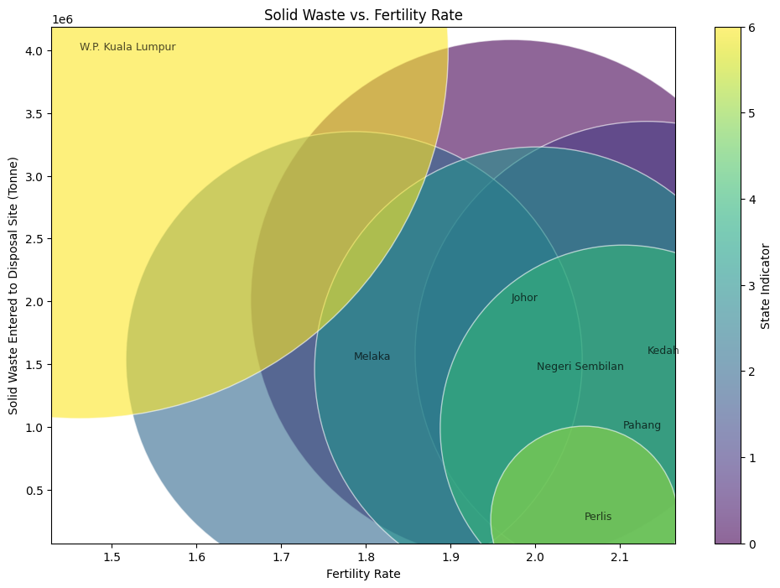
Analysis of Fertility Rate and Solid Waste Generation by State
Key Observations:
Lower fertility rates are associated with urbanization and economic activity, driving higher waste generation.
W.P. Kuala Lumpur, with the lowest fertility rate (~1.5), produces the most waste (>4 million tonnes).
Higher fertility rates in less urbanized areas result in lower waste generation.
Perlis, with the highest fertility rate (~2.1), generates the least waste (~500,000 tonnes).
Behavioral Insights:
Hoy et al. (2022): Fertility rates strongly influence waste types, including food, paper, and plastics, more than total population.
Novriadhy et al. (2021): High-fertility households produce less total waste, focusing on specific types like diapers and pharmaceutical waste.

Slide 15
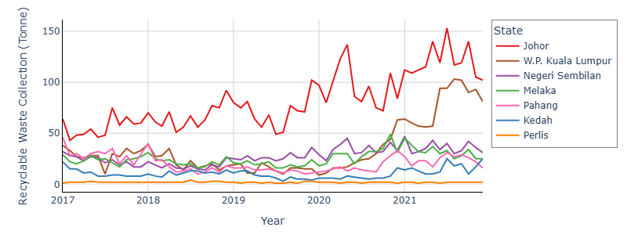
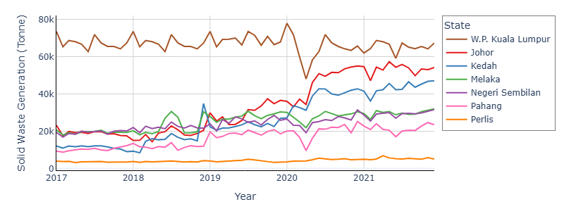
Statewise Trends in Recyclable Waste vs in Solid Waste Generation Over Time
Group | State | Solid Waste Generation (Trends) | Recyclable Waste Collection (Trends)
High Waste, High Recycling | W.P. Kuala Lumpur, Johor | W.P. Kuala Lumpur consistently generates the highest waste (60,000–80,000 tonnes) with a sharp decrease in 2020 which likely due to the COVID-19 pandemic. Johor is the second-highest contributor (40,000–60,000 tonnes) showing a steady upward trend. | Johor consistently leads in recyclable waste collection with a peak reaching over 150 tonnes around 2020. W.P. Kuala Lumpur follows with a gradual increase in recycling rates with a peak reach at approximately 100 tonnes in 2021
Moderate Waste, Moderate Recycling | Kedah, Melaka, Negeri Sembilan, Pahang | Moderate waste generation with Melaka and Negeri Sembilan trends almost identical likely due to their similar population sizes. | Negeri Sembilan, Melaka, Pahang, and Kedah show slight increases in recyclable waste collection particularly after late 2020.
Low Waste, Low Recycling | Perak | Generates the least waste that remained below 10,000 tonnes | Remains the lowest contributor, with collection levels consistently low throughout the years.
COVID-19 Impact Group | All States | Significant drop in 2020, rebound post-2020. Reduction of solid waste production as people stayed at home during the lockdown (Nasir et al., 2023). The relaxation of restrictions that allow eateries, hawkers, and markets to operate until 10pm, led to higher waste generation particularly plastic waste observed after June 2020 (Norkhadijah et al., 2023) | Recycling improved slightly during this time due to increased sustainability awareness (Bernama, 2020). This shift may have contributed to the slight upward trends seen in several states during and after 2020.
Malaysian Recycling Alliance (MAREA) Group | Johor, W.P. Kuala Lumpur | Stabilized waste production after 2021 due to urban recycling efforts.. | - MAREA campaigns boosted recycling efforts and helped stabilize waste production in urbanized states. - Reflects the success of targeted urban recycling initiatives.
Recyclable Waste Collection
Solid Waste Generation

Slide 16
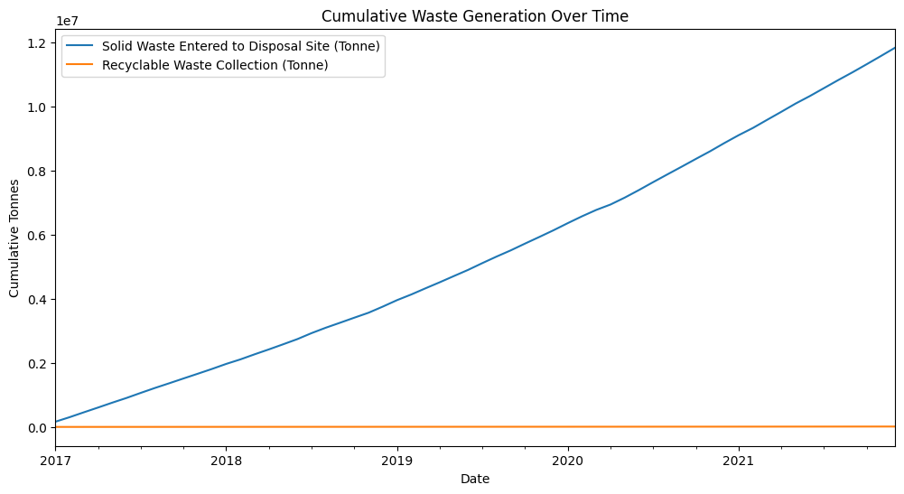
Cumulative Analysis of Solid and Recyclable Waste Generation Over Time
Solid Waste Generation
Total solid waste shows a steep upward trend, reaching ~12 million tonnes by 2021.
Key Drivers:
Improper waste stream management (Ishak, 2024).
ASEAN countries received 17% of global plastic waste (2017–2021).
China’s 2018 import ban redirected waste shipments to Southeast Asia, with Malaysia importing over 500,000 tonnes of plastic waste in 2021 while exporting only 11,000 tonnes.
Recyclable Waste Collection
Remains stagnant and contributes a small fraction of total waste.
Challenges:
Lack of recycling facilities and public awareness (Ishak, 2024; Nasir et al., 2021).
89% of waste ends up in landfills, reducing recycling opportunities.
Illegal dumping, poor operator practices, and unclear enforcement hinder progress.

Slide 17

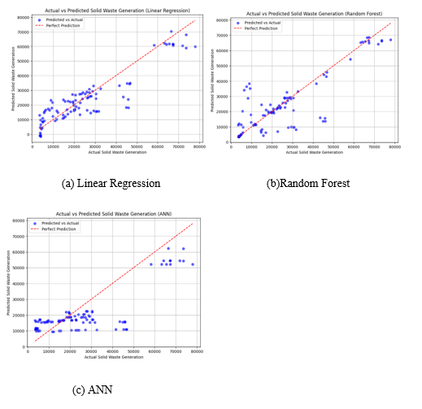
MODEL EVALUATION: COMPARISON MODEL PERFORMANCE
The R² score was the primary performance metric, as widely used in waste generation studies (A. Kumar & Samadder, 2017).
Results showed that MLR achieved the highest R² (0.82), outperformed RF (0.70) and ANN (0.58). The relatively lower ANN scores align with findings by Abbasi & El Hanandeh (2016) and Nasir et al. (2023), who emphasized ANN requires larger datasets for effective learning.
In terms of MAE, RF showed the best accuracy (6225.69) and ANN showed the worst performance.
With respect to RMSE, ANN demonstrated higher RMSE compared to MLR and RF. It indicates a greater sensitivity to larger errors.
ANN shows the least suitable model due to its lowest R2 and the highest error metrics.
RF consistently outperformed MLR because it was tuned through hyperparameter optimisation and cross-validation. (Dissanayaka & Vasanthapriyan, 2019; A. Kumar et al., 2018)

Slide 18

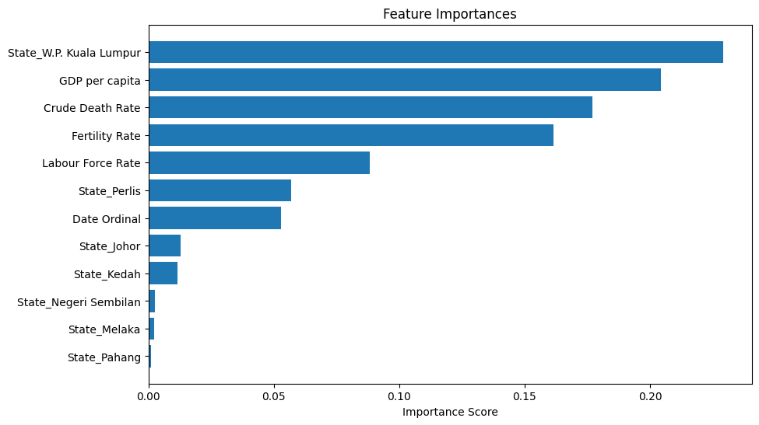
Tuned Random Forest Cross-Validation Result
5-fold cross-validation ensured balanced training and testing for reliable waste generation predictions (A. Kumar et al., 2018).
The best tuned Random Forest model used a maximum depth of 5, square root feature selection, a minimum sample split of 5, 128 trees, and a random seed of 42 for reproducibility.
Tuned Random Forest achieved an average R² of 0.85 and RMSE of 7354.93.
Consistent performance across folds, with the lowest R² at 0.80.
Tuned Random Forest is better suited to predict MSW due to its balanced accuracy and generalization compared to Linear Regression.
High importance of 'State_W.P. Kuala Lumpur' and GDP per capita highlights the impact of urbanization and economic activities on waste generation.
States like Pahang, Melaka, and Negeri Sembilan contribute less due to lower importance scores.
Findings align with Abdella Ahmed et al. (2022), Dissanayaka & Vasanthapriyan (2019), Azadi & Karimi-Jashni (2016), and Ghinea et al. (2016), showing urban centers generate higher per capita waste due to greater consumption and diverse waste streams.

Slide 19

Performance Metrics on Training and Test Datasets
Training Dataset Performance:
R²: 0.88 (explains 88% of variability).
RMSE: 6623.75 (low prediction error).
Indicates accurate model fit on training data.
Test Dataset Performance:
R²: 0.85 (captures 85% of variability on unseen data).
RMSE: 7537.56 (slightly higher than training RMSE but acceptable).
Model Reliability:
Minimal overfitting as the difference between training and test RMSE is small.
Reliable for predicting solid waste generation.

Slide 20
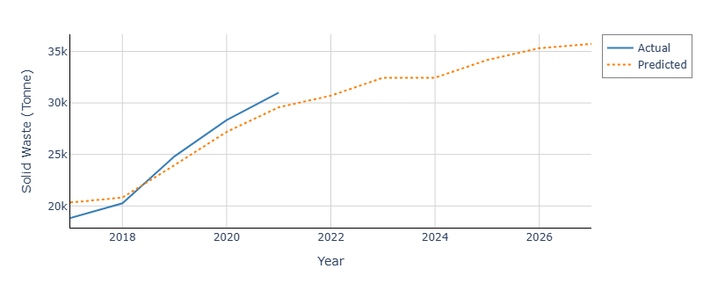
Yearly Mean Actual vs Predicted Solid Waste Generation
Model Performance (2017–2021):
Predicted values closely align with actual yearly means, capturing the overall upward trend in solid waste generation.
Model fails to capture short-term variations, such as the drop in 2020, due to yearly aggregated features lacking granularity.
Forecast Beyond 2021:
Predicts slower growth in waste generation, stabilizing at ~35,000 tonnes by 2026.
Suggests a saturation point influenced by socioeconomic and demographic factors.

Slide 21
CONCLUSION
Predictive modeling effectively forecasts MSW generation using socioeconomic and demographic factors.
Significant contributors: GDP per capita, crude death rate, fertility rate, and labor force participation.
Optimized Random Forest emerged as the best model (R²: 0.85, MAE: 5239.97, RMSE: 7537.56).
Forecasts indicate a rising trend in waste generation, with W.P. Kuala Lumpur and Johor as major contributors.
Simpler ML models can perform well with straightforward parameter tuning, while advanced models need larger datasets and intensive optimization for better accuracy.

Slide 22
LIMITATION
RECOMMENDATION
Data Granularity:
Annual data limits capturing monthly/seasonal variations.
Future work should include more granular and dynamic data.
Dataset Size:
Small dataset limits model generalizability and ability to detect rare patterns.
Expanding data with more states and longer timeframes could improve results.
Model Improvement:
Further optimization of ANN could address outliers and handle complex patterns.
External Variables:
Dynamic factors like policy changes, technological advancements, and public campaigns were not included.
Future research should incorporate these variables for a holistic approach.
Public Awareness:
Educate households on waste separation, disposal practices, and composting.
Address misunderstandings about food date labels to reduce food waste.
Retail and Food Recovery:
Reduce the strict cosmetic standards for the fresh produce in retailers.
Offer tax incentives for food donations.
Adopt advanced technology for inventory tracking and demand prediction.
Policy Integration:
Use predictive models to guide waste management policies, resource allocation, and infrastructure planning.
Collaborate with KPKT, SWCorp, and local councils to improve recycling and waste reduction efforts.

Slide 23
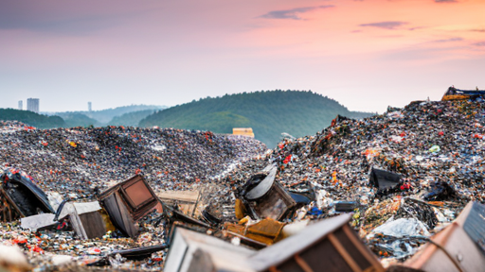
THANKS!
DO YOU HAVE ANY QUESTIONS?
22120931@siswa.um.edu.my

